Slide 1
Time-Series Momentum Strategy
-By Rakshay Pawar

Slide 2
Introduction to Time-Series Momentum Strategy
Evidence shows that in every decade since 1880, time series momentum has yielded positive average returns with a low correlation to traditional asset classes.
Strategy exhibits consistent profitability in different macro environments such as recessions, booms, war and peacetime, high- and low-interest rate regimes, high- and low-inflation periods.
Evaluation includes considering of the effects of fees, transaction costs, and benefits of allocating to a trend-following strategy from a traditional stock/bond portfolio.

Slide 3
Data and Strategy Construction
Data: In our analysis, we use daily returns for financial markets across three major asset classes: commodities, equity and forex.
Constructing the strategy:
Trend-following investing: long positions on rising markets. Long-short strategy
Equal weights across each asset class: equity, commodities and forex
Choose the best performing asset across each asset class.
The position is determined by assessing past returns over the relevant lookback horizon.
Transaction costs and fees are subtracted from total return and estimates based on recent averages for each asset class and historical comparison.
Compute annualized excess return, volatility, and Sharpe ratio for the strategy returns.

Slide 4
Detailed momentum strategy used by the code
This Python script extensively analyses different financial assets, including stocks, commodities, and forex. The analysis is done from a momentum trading perspective, where it's believed that stocks that have performed well in the past will continue to do so in the future. Conversely, stocks that have performed poorly in the past will continue to do poorly.
Data preprocessing: It creates a copy of the input DataFrame, removes any rows with missing data, converts the 'Date' column to DateTime format, and sets it as the index. The data frame is then sorted by 'Date'.
Returns calculation: It calculates daily returns, the percentage change in 'Price' from the previous day.
Momentum signals: It calculates momentum signals based on three lookback periods: 21, 63, and 252 days. These periods are commonly used in trading and are approximate representations of 1 month, three months, and one year. A positive momentum signal suggests that the asset's price has been increasing over the lookback period, while a negative signal suggests it has decreased. It also calculates the average momentum signal.
Momentum returns: It calculates the momentum returns, which is the product of the momentum signal from the previous day and the daily return.

Slide 5
Detailed portfolio construction:
The three assets are selected because they have the highest Sharpe ratio in their respective asset class. The assets r equally weighted in the portfolio.
The script conducts a comprehensive financial analysis of several different financial assets ('S&P500', 'ICESUGAR', 'USDJPY') based on a momentum strategy and consolidates them into a single portfolio. The momentum strategy is based on the premise that assets that have performed well in the past will continue to perform well, and assets that have performed poorly will continue to do poorly.
Let's break down the steps that are implemented:
Daily Returns Calculation: It calculates the daily returns, representing the percentage change in the 'Price' from the previous day to the current day.
Momentum Signals Calculation: It then defines a function to calculate the momentum signals based on three lookback periods: 21 days (approx. one month), 63 days (approx. three months), and 252 days (approx. one year). The momentum signal is the sign of the mean of the past returns over the lookback period. The sign function will return 1 for positive returns (indicating price increase), -1 for negative returns (implying price decrease), and 0 for no change.
Momentum Returns Calculation: It calculates the momentum returns for each asset, which is the product of the previous day's momentum signal and the current day's returns; this represents the return you would have obtained if you followed the momentum strategy, bought the asset when the signal was positive, and sold it when it was negative.
Transaction Costs and Fees: The code can add transactional costs. These are often included in real-world scenarios and would be subtracted from the returns to get the net returns. For this analysis, the net momentum returns are the same as the momentum returns.
Portfolio Returns Calculation: It stores the net momentum returns for each asset in a DataFrame portfolio_returns. The portfolio returns are then calculated as the mean of the returns of all investments for each day.

Slide 6
Detailed momentum strategy used by the code
Performance Metrics Calculation: It calculates the portfolio's annualized return, volatility, and Sharpe ratio. The annualized return is the mean daily return multiplied by the number of trading days in a year (assumed to be 252). The annualized volatility is the standard deviation of the daily returns multiplied by the square root of the number of trading days in a year. The Sharpe ratio is the annualized return divided by the annualized volatility. It measures the performance of the portfolio relative to the risk taken
Transaction costs and fees: We have an option in the code to add trans costs. It is 0 right now. It defines placeholders for transaction costs and fees, which must be subtracted from the returns in a real-world scenario to calculate net returns.
Annualized returns, volatility, and Sharpe Ratio: It calculates the asset's annualized returns, annualized volatility, and Sharpe ratio. The Sharpe ratio measures the performance of an investment compared to a risk-free purchase after adjusting for its risk.
T-statistic: It calculates the t-statistic for the net momentum returns. This statistical measure tests the hypothesis that the mean of the net momentum returns is not significantly different from zero.
Results collation: It compiles all these metrics into a results data frame.
This enables a quantitative momentum strategy analysis across various financial products, directly comparing these products based on their historical performance. This is useful for developing an investment portfolio and evaluating which assets might yield the best risk-adjusted returns based on their past momentum.

Slide 7
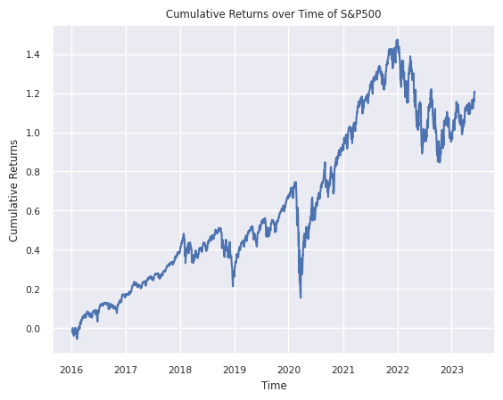
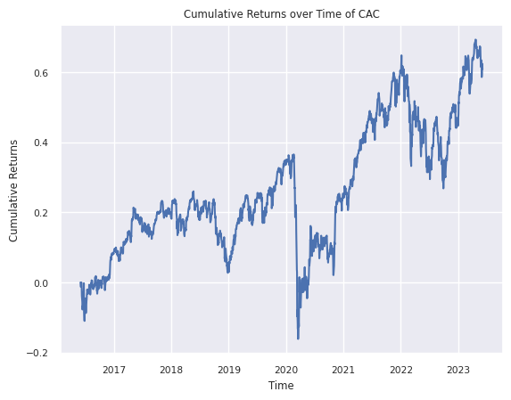
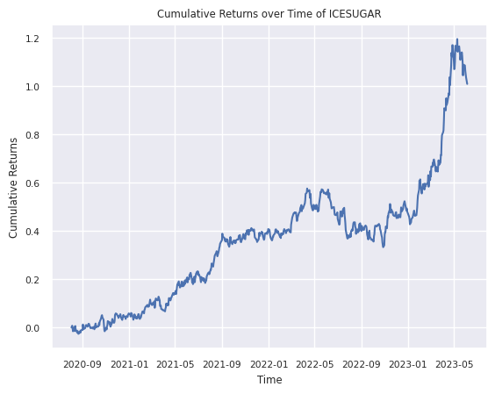
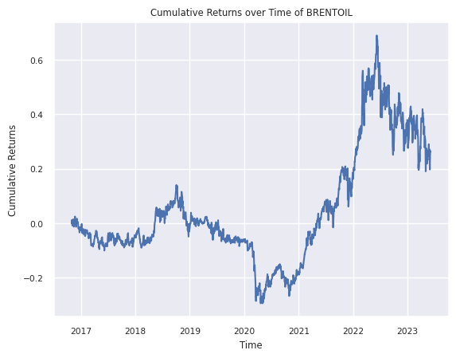
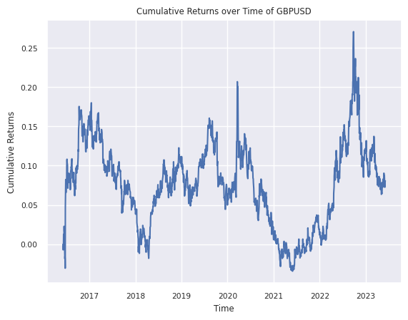
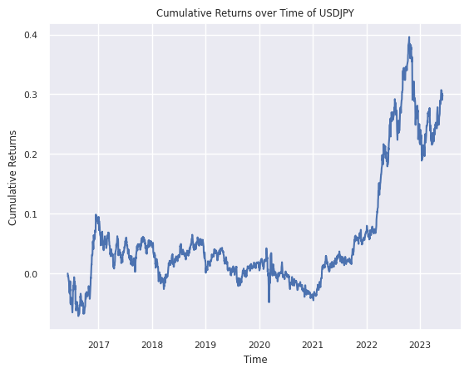

Slide 8
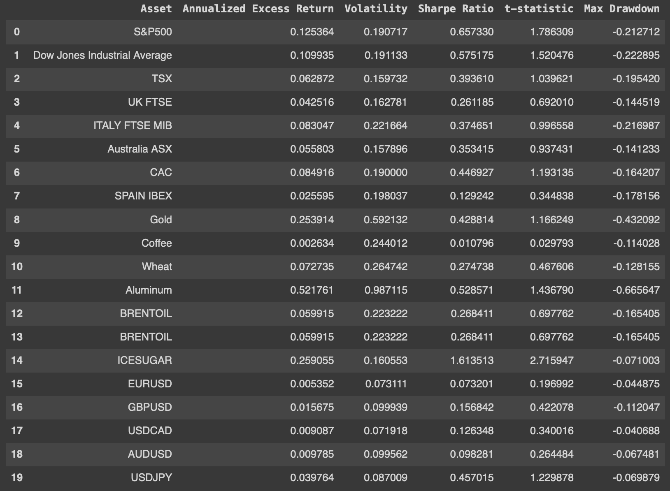
Asset performance

Slide 9
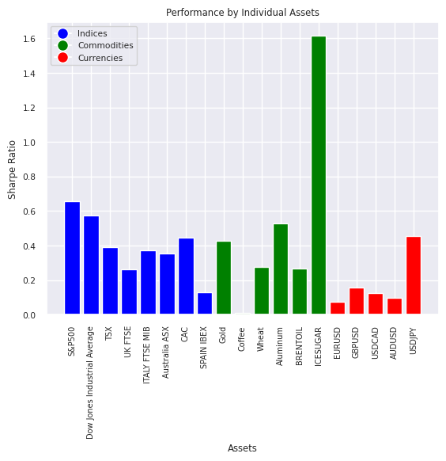
Asset Performance
Indices best performing asset : S&P500
Commodities best performing asset : ICESUGAR
Currencies best performing asset : USDJPY

Slide 10
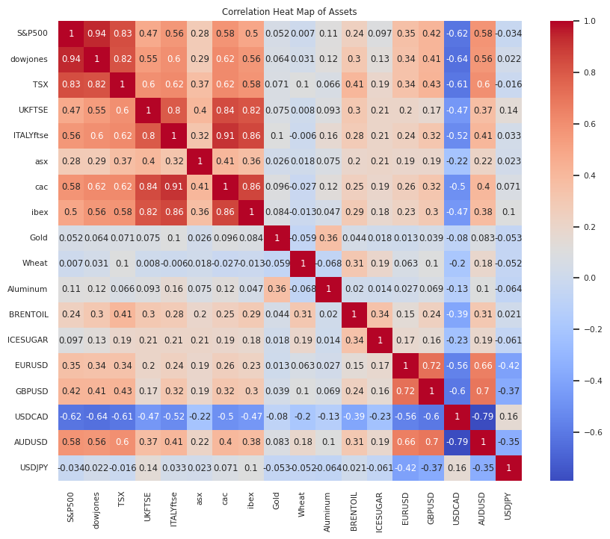
Asset Correlation
High positive correlation between the indices
Low positive correlation between indices and commodities
Low negative correlation between commodities and currencies
Negative correlation across a few currencies

Slide 11
Implementation of the Strategy
Identification of Trends: Analyze past returns to determine market trends
Positioning: Take long positions on upward trends showing momentum
Risk Management: Adjust position sizes based on asset volatility for constant risk
Portfolio Construction: Apply strategy across a diverse range of assets for better risk-adjusted returns

Slide 12
Pros and Cons of Time Series Momentum Strategy
Pros:
Diversification: Can be applied across various asset classes.
Historical Performance: Delivers positive returns over long periods and across different market environments.
Adaptable to different market conditions: such as recessions, booms, war and peacetime, high- and low-interest rate regimes, high- and low-inflation periods.
Cons:
Transaction Costs: Frequent trading can lead to high transaction costs.
Dependence on Trends: Performance is dependent on the existence of price trends.
Risk of Large Losses: Despite risk management techniques, there is a risk of significant losses in volatile and fast-moving markets.

Slide 13
Strategy Features
How Time Series Momentum Strategy Diversifies the Portfolio:
Exhibits low correlation with traditional asset classes, aiding diversification
Focuses on persistent price trends, generating returns uncorrelated with traditional assets
Can generate positive returns even during market turbulence
Reduces overall portfolio risk through dynamic exposure adjustments
Choice of Assets for Our Analysis:
Stocks: Captures trends in individual stocks or stock indices
Commodities: Exploits trends driven by supply-demand dynamics and global conditions
Currencies: Profits from trends in currency exchange rates

Slide 14
Results

Slide 15
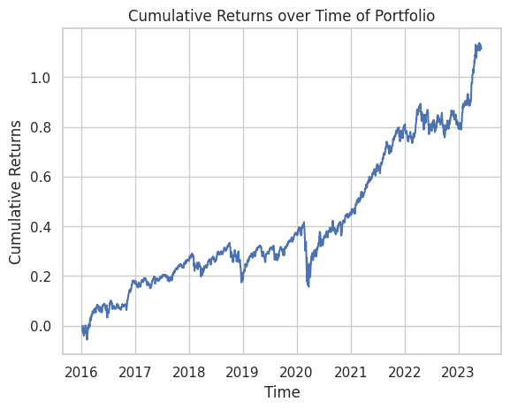
Cumulative Returns over Time of Portfolio
Portfolio Annualized Excess Return: 0.10752087462653226
Portfolio Volatility: 0.11113749201978658
Portfolio Sharpe Ratio: 0.9674581698081649

Slide 16
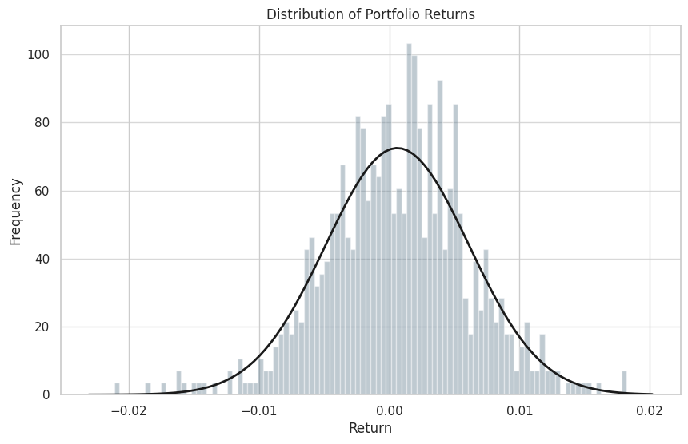
Distribution of Portfolio Returns
Almost standard normal with slight left skewness.

Slide 17
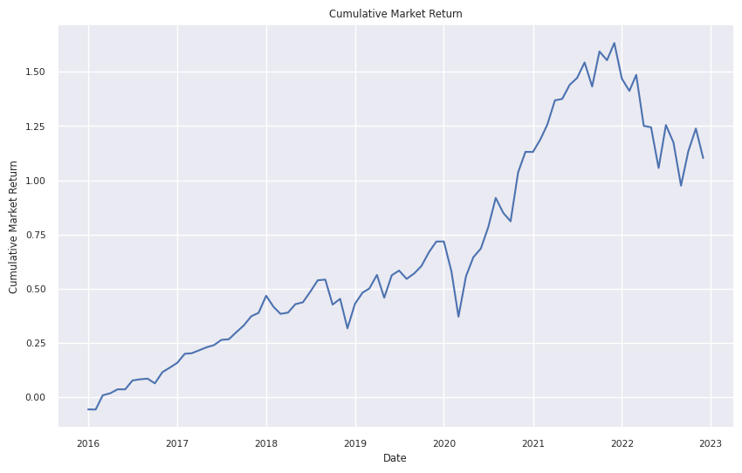
Fama French
Sharpe ratio: 0.6565733748070015
Annualized mean: 0.12087142857142859
Annualized standard deviation: 0.1692336149740272

Slide 18
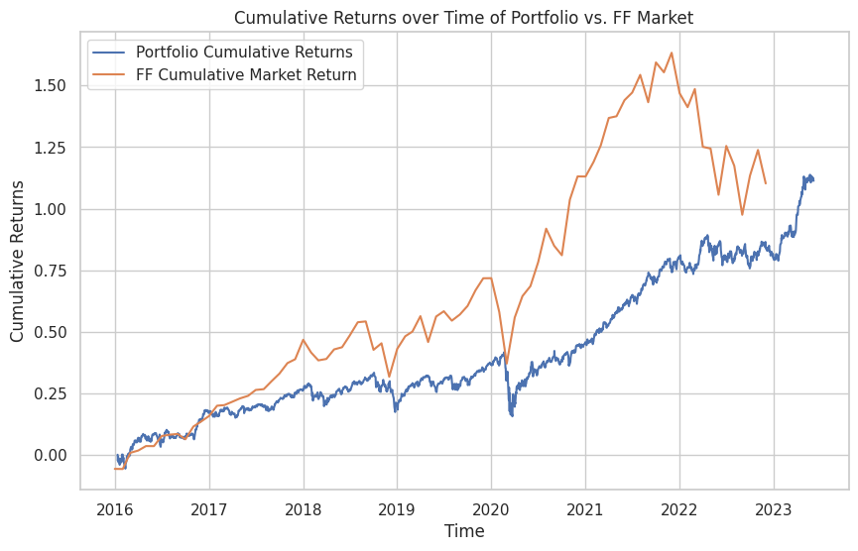
Fama french market return (Mkt) vs portfolio
The cumulative return is roughly the same, but we have a way better Sharpe ratio. 0.96 vs 0.65.

Slide 19
Q & A

